Slide 1

ISO 20022 New Group Member
Welcome Pack
July 2024

Slide 2
ISO 20022
A single standardisation approach, a common ‘recipe’ – which includes a common development methodology, a common process and a common repository - to be used by ALL financial standards initiatives.

Slide 3
ISO 20022 recipe
Main ingredients
Development / registration process
Clearly identified activities and roles
Business experts and future users involved upfront
Technical experts involved when required
Repository on the ISO 20022 website
Business Process Catalogue & Data Dictionary
Outside of official standard (maintained by registration bodies)
www.iso20022.org

Slide 4
The eight parts of ISO 20022
Part 1: Metamodel
Part 2: UML profile
Part 3: Modelling
Part 4: XML schema generation
Part 5: Reverse engineering
Part 6: Message transport characteristics
Part 7: Registration
Part 8: ASN.1 generation
Copies can be obtained from www.iso.org

Slide 5
ISO 20022 Governance

Slide 6
International Organization for Standardization (ISO)
163 Countries
National Standards Bodies (BSI, ANSI, AFNOR, DIN, UNI, etc…)
General Assembly
Central Secretariat
Council
Technical Management Board (TMB)
262 Technical Committees
TC
TC
TC 68
Financial
Services
TC
513 Subcommittees
ISO 20022
RMG
SC 2
Security
SG 4
Communications
SC8
Reference Data
SC 9
Messaging
2,516
Working Groups
WG
WG
WG
WG 7
WG
WG
AG1
WG 4
WG
AG 5
Digital Currencies

Slide 7
ISO 20022 governance - Main ISO 20022 groups
RMG / Submitters / RA / TSG
Registration Management Group (RMG)
The RMG is ultimately accountable for the ISO 20022 Governance Procedures and the ISO 20022 Registration Procedures on behalf of the users.
The role of the RMG is to promote and support the involvement of financial service actors to facilitate the registration and maintenance of high quality globally relevant ISO 20022 compliant business models for exchange of information for financial services.
Submitters of new messages and maintenance requests
The user communities in the registration process are typically represented as “submitting organisations” or “submitters” who bring in proposals to add new messages to the existing catalogue of messages
Registration Authority (RA)
The RA is responsible for the effective execution of the registration process.
Technical Support Group (TSG)
The TSG provides technical support to the other registration bodies and the Submitting Organizations or communities of users, upon their request

Slide 8
ISO 20022 governance - Main ISO 20022 groups
SEGs / CSH / ET
Standards Evaluation Groups (SEGs)
The Standards Evaluation Group (SEG) provides a business-driven validation of the candidate ISO 20022 message definitions and API resources that are to be published under the auspices of ISO.
Following SEGs are currently existing:
  Payments SEG
  Securities and related Sub-SEG
  Cards SEG
  FX SEG
  API resources SEG
  Trade Finance SEG
Cross SEG Harmonisation (CSH)
The CSH is responsible for taking business decisions regarding the consistency and harmonisation of business processes, business and message components/elements, and potentially data content in terms of codes, across financial business areas.
Evaluation Teams
Pools of subject matter experts that are pulled together with the appropriate mix of expertise as required to evaluate the submitted candidate ISO 20022 messages or requests to change existing ISO 20022 messages.

Slide 9

ISO 20022 Registration Authority (RA)
Your main contact point for any questions related to ISO 20022
Registration Authority (RA) : Roles and Responsibilities
Entity appointed by ISO to fulfil the registration services
Reports to ISO TC 68/SC 9, that is responsible for the management and oversight of the ISO 20022 standard.
Maintains an accurate ISO 20022 financial repository
Provides the registration services, including the maintenance of the www.iso20022.org website.
Ensures compliance of developed ISO 20022 repository items with the approved technical specifications
Publishes the financial repository on the www.iso20022.org website.
Full member of the Registration Management Group and its sub-groups, the Standards Evaluation Groups and the Technical Support Group.
Maintains the relationships with the different ISO 20022 governance bodies helping the RMG, which includes maintaining the official member lists management of the RMG, SEG/SubSEGs/ETs and TSG
For any questions, please contact us at iso20022ra@iso20022.org

Slide 10
Being a Member of an
ISO 20022 Group
See the ISO 20022 Governance document for full details

Slide 11
ISO 20022 Groups
Mission and scope of the RMG
RMG (Registration Management Group)
Acts as an overall representative of the ISO 20022 standard on behalf of this broad set of communities of users regardless of membership of the RMG and ensures that the ISO 20022 standard is effective from a user perspective.
Is ultimately accountable for the ISO 20022 Governance Procedures and the ISO 20022 Registration Procedures on behalf of the users and the RA is responsible for the effective execution of the registration process.
Promotes and supports the involvement of financial service actors to facilitate the registration and maintenance of high quality globally relevant ISO 20022 compliant business models for exchange of information for financial services.
Essential activities of the RMG in support of this objective in the context of the registration activities are to:
  Support the Registration Process and respond to technical and business challenges related to the groups supporting the RA including the set-up/disbandment of other registration groups;
  Review and approve Business Justifications for the development of new ISO 20022 message sets and API resources in order to manage the business scope of the ISO 20022 repository;
  Seek to achieve full coverage of financial services activities while preventing scope expansion into non-relevant areas;
  Provides a contact point for any organisation wishing to engage with the ISO 20022 standard;
Ensure that ISO 20022 is a trusted standard providing high quality business models for exchange of information for financial services.

Slide 12
ISO 20022 Groups
Registration Management Group (RMG)
RMG Leadership team
The duties of the RMG Convenor, Vice-Convenors and Secretary are detailed in the dedicated sections of the ISO 20022 Governance
One RMG Convenor
Represents, with support of the Vice Convenors , the RMG in- and externally, presides the RMG meetings and sets its agenda, oversees the work of its Sub-Groups and related governing bodies and provides general direction in accordance with the agreed RMG strategy. The head of the RA as part of the RMG leadership complements and supports the RMG leadership. The RMG Secretary in its role, facilitates and supports the RMG leadership.
Two RMG Vice-Convenors
Work with the RMG Convenor and perform duties as required or otherwise delegated by the RMG Convenor, including but not limited to representing the RMG in interactions with external bodies, leading specific agenda items, or taking ownership for following up on resolutions.
Act as liaisons, where required, with sub-groups of the RMG, other ISO bodies and local standard organizations.
RMG Secretariat
The elected RMG Convenor is responsible for making sure that resources are available to provide the RMG secretariat during his/her term of office. The RMG Secretary acts as a point of contact for all RMG members.

Slide 13
ISO 20022 Groups
Roles and Responsibilities of an RMG participant
RMG Member
Each member entity is entitled to nominate a delegation of one principal and two alternates to the RMG.
No more than two delegates may attend any meeting and it is expected that one of those two will act as the lead delegate in any decision making.
Each of the members in a delegation is strongly encouraged to serve for a period of at least 3 years to help ensure consistency and retain knowledge and experience of the ISO 20022 registration and approval processes. Any member may nominate a permanent replacement to their delegation at any time informing the RMG Secretariat and RA in writing (email is considered sufficient). The RA must be notified
Attendance by delegation members is strongly recommended and to be actively encouraged by regular communication with persistent no-show delegations to stress the importance of attendance. Ultimately, if a delegation continually fails to attend, further action may be taken.
RMG Observer
Acceptance of attendance to RMG meetings may be granted at the discretion of the Convenor.
Shall be identified as an observer during RMG meetings and may speak or provide information only if directly requested by the Convenor.
Shall not participate in decisions and cannot join any sub-groups created by the RMG unless specifically invited.

Slide 14
ISO 20022 Groups
Mission and scope of the SEGs and ETs
Standards Evaluation Group (SEG)
Each SEG is assigned as dedicated subsets of the financial industry business activities
SEG members are the representatives of the (future) end-users of ISO 20022 messages and API resources
Verifies that the proposed models, messages and API resources are within the scope approved by the RMG
Evaluates the benefits of the proposed sets of messages as well as the business, and possibly the impact on existing applications and processes.
Ensure that the candidate ISO 20022 models, messages and API resources proposed for worldwide adoption address the actual needs of the targeted community of users.
Evaluation Team (ET)
Pools of expertise, pulled together by the SEG Leadership to form ETs with the required mix of expertise to evaluate the submitted candidate ISO 20022 messages or requests to change existing ISO 20022 messages.
Evaluation Teams may include invited experts, which are not member of the SEG
Sub-SEG
Separate standing group to cover a subset part of the scope of a SEG (such regulatory reporting or derivatives)
A Sub-SEG behaves like a SEG, but remains closely associated with its parent SEG, especially for the decisions of a Sub-SEG which must be ratified by the parent SEG

Slide 15
ISO 20022 Groups
Standards Evaluation Groups, Technical Support Group,
Cross SEG Harmonisation Leadership
One Convenor
Prepares the meeting agendas and runs all SEG/TSG/CSH meetings and is responsible for the organisation of the SEG/TSG/CSH. For the SEG, the Convenor is also responsible for the initiation of required Evaluation Teams (for the review of new submissions), the timely planning of evaluations and the communication of evaluation results.
The Convenor and Vice Convenor are "ex-officio" members of the RMG and are responsible for all communication to the RMG, the RA, the TSG, the CSH and the other SEGs. In particular, the Convenor is expected to attend RMG meetings and deliver a SEG activity report to the RMG. The Convenors are members of the CSH.
One Vice-Convenor
Assists the Convenor and takes over any time the Convenor is unavailable.
Secretary
Arranges for meetings and conference calls;
Takes minutes / action points at the meetings and posts them to the SEG members on a timely basis;
Communicates to the RA any updates to the SEG and Evaluation Team membership;
Makes sure that the evaluation results, including collated comments from the Evaluation Teams, are logged in the ISO 20022 Workspace for archiving and future reference.

Slide 16
ISO 20022 Groups
Mission and scope of the TSG and the CSH
Technical Support Group (TSG)
Provides technical support to the other registration bodies and the Submitting Organizations or communities of users, upon their request.
Advises the Submitting Organizations, the RMG, the RA, the CSH and the SEGs on the most appropriate and consistent interpretation of the ISO 20022 standard and on matters related to the technical efficiency and integrity of the registration process.
Prepares the meeting agendas and runs all SEG/TSG/CSH meetings and is responsible for the organisation of the SEG/TSG/CSH. For the SEG, the Convenor is also responsible for the initiation of required Evaluation Teams (for the review of new submissions), the timely planning of evaluations and the communication of evaluation results.
The Convenor and Vice Convenor are "ex-officio" members of the RMG and are responsible for all communication to the RMG, the RA, the TSG, the CSH and the other SEGs. In particular, the Convenor is expected to attend RMG meetings and deliver a SEG activity report to the RMG. The Convenors are members of the CSH.
Cross SEG Harmonisation Group (CSH)
Takes business decisions regarding the consistency and harmonisation of business processes, business and message components/elements (for example, Business Level concepts and the traces to the Logical/Message Level Concepts), and potentially data content in terms of codes across financial business areas, contributing to a concise and well-defined glossary of business terms, business data semantic definitions, and structuring of data exchanges.
Reviews new Business Justifications received by the RA and identifying which SEG(s) will need to be involved in the evaluation of the proposed new set of messages. Or API resource
Assists the TSG in reviewing any change requested to the Business Application Header (BAH), gauging the impact of introducing new versions of the BAH and the best timing thereof, considering the situation of each SEG.

Slide 17
ISO 20022 Groups
Roles and Responsibilities of a group member in the process
SEG Member
Representative of the (future) end-users of ISO 20022 messages and API resources
Verifies that the proposed models, messages and API resources are within the scope approved by the RMG, they evaluate the benefits of the proposed sets of messages as well as the business, and possibly the impact on existing applications and processes.
Ensures that the candidate ISO 20022 models, messages and API resources proposed for worldwide adoption address the actual needs of the targeted community of users.
Approves the candidate ISO 20022 message definitions and API resources for registration and publication
ET/Sub-SEG Member
Member with an expertise in the business area for which the ET or the Sub-SEG has been put in place by the SEG
Evaluates the submitted candidate ISO 20022 messages or requests to change existing ISO 20022 messages.

Slide 18
ISO 20022 Groups
Getting Access to the documentation as a participant in a group
ISO 20022 Website
The iso20022.org website provides all information related to ISO 20022, the ISO 20022 repository and especially the catalogue of:
  all business submissions (Message and API Resources development requests)
  all Change Requests
  all approved message definitions
Dedicated ISO 20022 Workspace for the group
The RA invites new members to register for the ISO 20022 Workspace
The SEG Secretary or the RA post material to the relevant folder in the ISO 20022 Workspace
The SEG member list is also made available to the stakeholders through the ISO 20022 Workspace
Any distribution of documents, by whatever means, must also be available to the ISO 20022 Workspace stakeholders.

Slide 19
Main ISO 20022 processes

Slide 20






Using ISO 20022 modelling to achieve interoperability
Date
Account
All institutions have their own sets of data objects
Order
ISO standardizes common data objects…
Order
Date
…and groups them into ‘syntax-neutral’ message models, which...
Date
… can be ‘transformed’ in message formats in the desired syntax
ASN.1
FpML
XML
ISO 15022
FIX
Notes:
Syntax-independent business modelling is key to the ISO 20022 standard…
The models evolve with the business, while the formats evolve with the technology to benefit from the latest innovations with regard to automation, ease of implementation, openness and cheapness of products, etc. The ISO 20022 recipe offers a better, cheaper and faster way of developing and implementing interoperable message standards.
The current preferred ISO 20022 syntaxes are XML and ASN.1, but should a new and better syntax be chosen, the models would not need to be changed: only the rules to transform the message models in the desired message formats would change. Furthermore, if it is more efficient to use another syntax for a particular business area or a particular market segment, the use of the ISO 20022 message models ensures that the business information will flow smoothly from one message to another whichever the syntax used to transport this business information.

Slide 21
ISO 20022 Groups
Business justification registration process (new submissions)
R
M
G
m
o
n
i
t
o
r
s
Submitting
organisation
Financial industry group or standards body
Business
justification
Business justification
Project approval & allocation to a SEG
RMG
Candidate ISO 20022 messages
Submitting organisation
& RA
Development & provisional registration
Business validation
SEG
ISO 20022 messages
Official registration
and publication
RA
Repository
Submitting organisation
& users
Optional pilot testing
or first implementers
Dictionary
Catalogue
Notes:
Once the Business Justification is approved by the RMG, and as long as the messages have not been approved by the SEG, the messages are called ‘candidate ISO 20022 messages’. Once they are approved by the SEG for publication, the messages are called ‘ISO 20022 messages’ or ‘ISO 20022 compliant messages’.

Slide 22
ISO 20022 Groups
Yearly maintenance process
Timing
By June 1
Users CRs
Users introduce Change Requests to the RA
By July 7
SEG
SEG screens Change Requests (CRs)
Submitting
organisation
Submitting organisation prepares ‘Maintenance Change Request’ with each CR implementation
By August 21
By October 1
SEG
SEG approval/rejection
Submitting organisation
& RA
Development of candidate new versions
Provisional publication
By December 1
By February 1
SEG
Validation of new versions
By February - May
RA
Registration and publication
Submitting organisation
& users
First implementers
Notes:
Once approved, the ISO 20022 messages can be maintained upon request of the users or submitting organisations.
There are several kinds of maintenance processes, to adapt to the needs and urgency of each community of users.
The ISO 20022 maintenance processes are described at http://www.iso20022.org/maintenance.page
.

Slide 23
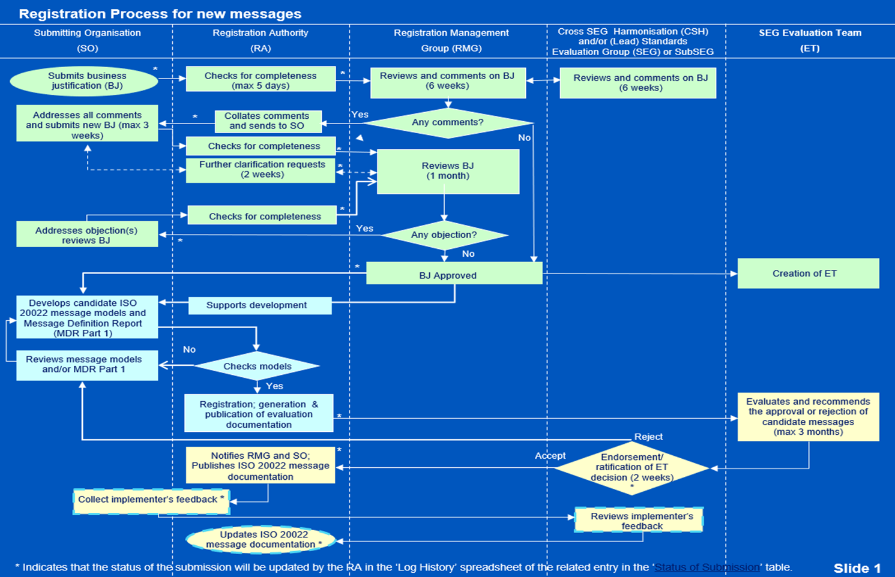
ISO 20022 Groups
Business Justification Registration Process (new message submissions)

Slide 24
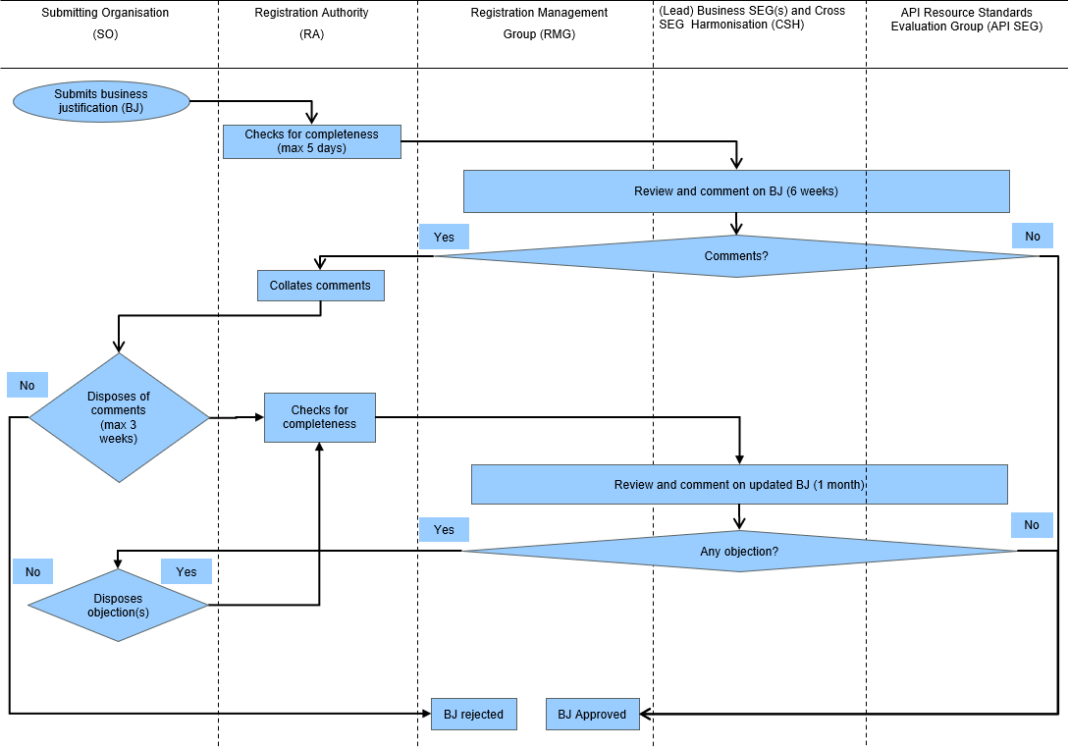
ISO 20022 Groups
Business Justification Registration Process (new API resource submissions)

Slide 25
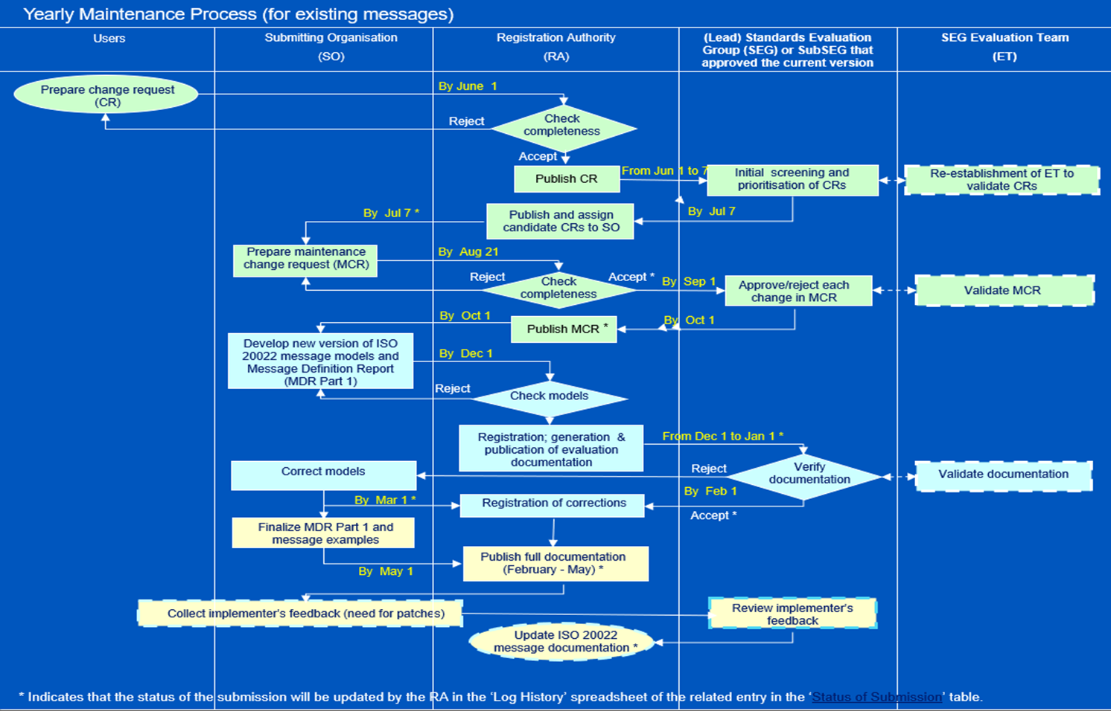
ISO 20022 Groups
Yearly Maintenance Process

